Slide 1
NETWORKING AND SYSTEM UPDATES
WELCOME TO MODULE 8

Slide 2
SECTIONS
Section I- What is NIC?
Section II- Enable internet on the VM
Section III- NIC Teaming
Section IV- Network Configuration
Section v- Windows Updates
Section VI- NTP Configuration
Section VII- File Transfer Methods
Section VIII- FTP Server Installation and Configuration
Section IX- Sharing File System (Samba or NFS)
Section X- WSUS Server Installation and Configuration
Section XI- Windows Firewall

Slide 3
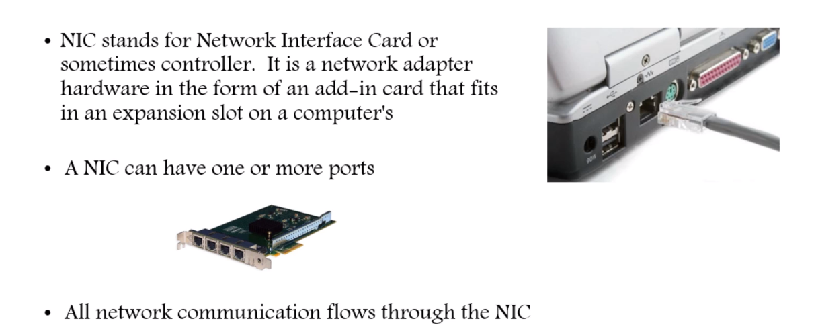
Section I- What is NIC?

Slide 4
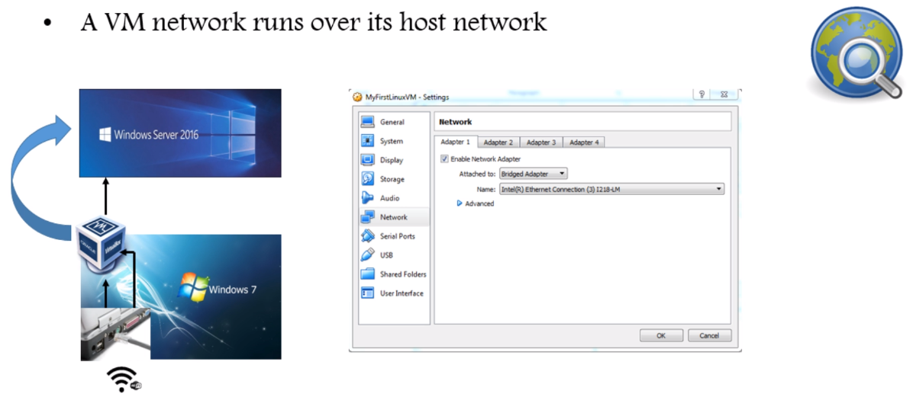
Section II- Enable internet on the VM

Slide 5
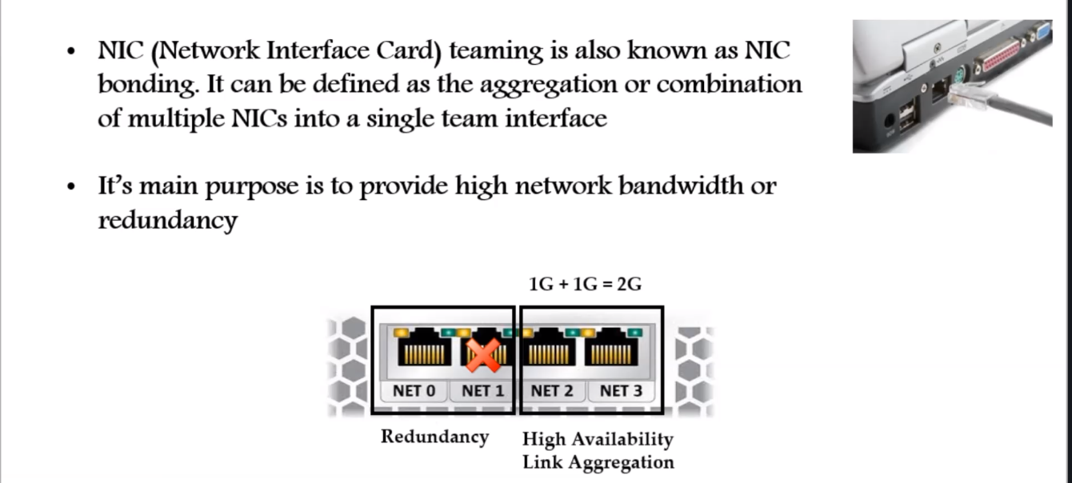
Section III- NIC Teaming

Slide 6
Difference between Bridged and Teaming:
Bridged mode is a simplified version of teaming. In a nutshell all bridging does is allow the computer to see both network connections as 1, and use the bandwidth of both at the same time. It's also the only "teaming" type option available on non-server OS's.
Teaming is more geared towards throttling and stability. Normally teaming is setup so that 1 line is in, and 1 line is out. This prevents the server from being over-run with too much incoming traffic such that the outgoing suffers, and vice-versa

Slide 7
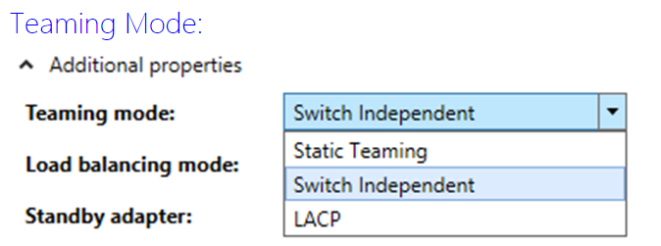
Teaming Mode

Slide 8
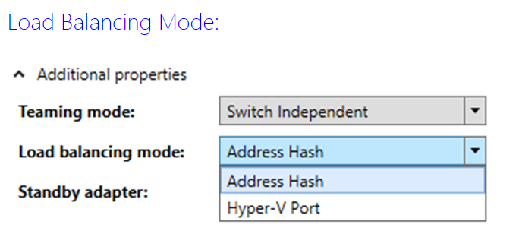
You can configure your team for either Static Teaming, Switch Independent, or LACP (Link Aggregation Control Protocol). Static Teaming requires configuration on the switch and the computer to identify which links form the team. Because this is a statically configured solution. This is a switch dependent mode of NIC teaming. Switch Independent mode allows you to distribute the NICs in your team across numerous Network Switches in your environment. LACP provides the Link Aggregation and allows for the expansion and reduction of the NIC team. This is a switch independent mode of NIC teaming.

Slide 9
Address Hash is how you configure your team to load balance network traffic between the NICs in the team. Hyper-V Port load balancing will load balance your traffic by VM. With Hyper-V Port, the good news is that each VM will transact on a separate NIC, but the down side is that each VM will only transact over a single NIC. If you have multiple virtual NICs in your VM and they are teamed, the Hyper-V Port may be the best choice. For most configurations, I expect that the Address Hash will be your best choice to allow your VM to still access the network in case the NIC the VM is utilizing fails. Remember that with Hyper-V Port the failure of the NIC the VM is utilizing disrupts communication between the VM and the network. Address Hash won’t have this problem

Slide 10
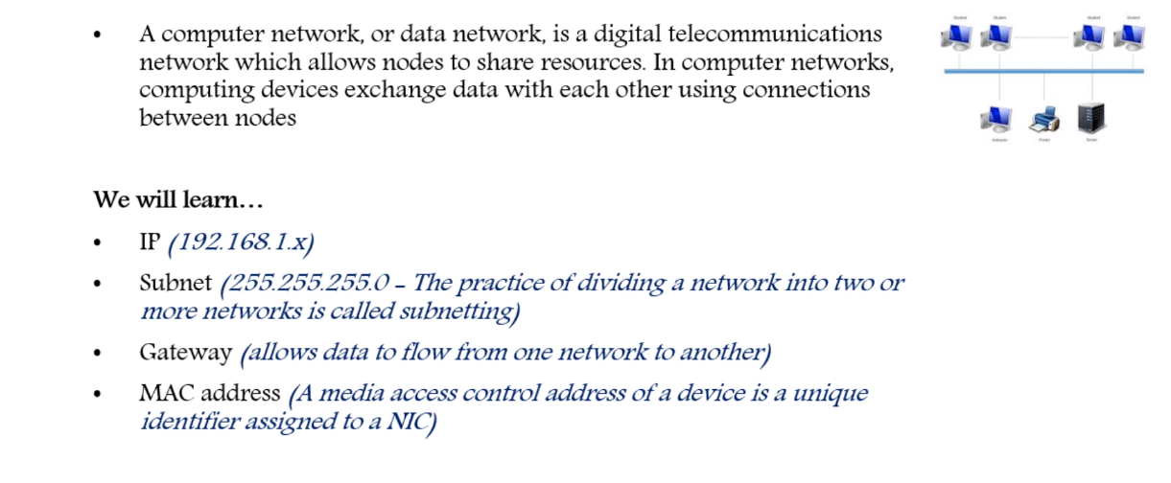
Section IV- Network Configuration

Slide 11
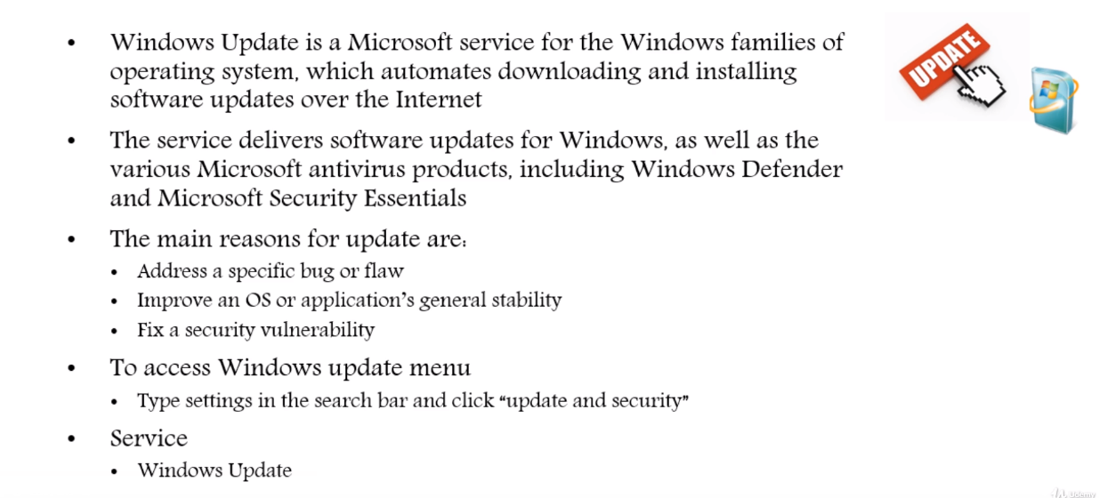
Section v- Windows Updates

Slide 12
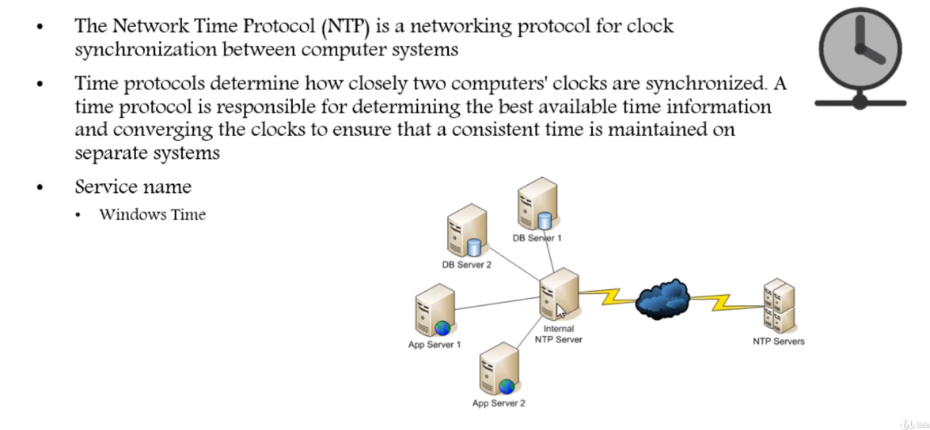
Section VI- NTP Configuration

Slide 13
Commands to configure NTP on Windows 2016
To configure Windows Time Service
Type the following command on powershell:
W32tm /config /manualpeerlist:pool.ntp.org /syncfromflags:MANUAL
Use the command to stop the service:
Stop-service w32time
Use the command to start the service:
Start-service w32time
Now the Windows Server 2016 is an NTP client of pool.ntp.org and its time/clock is synced with the NTP pool servers (The server is at the same time the NTP server for other domain client systems).
Then go to the client machines and run the following command on PowerShell to force them to sync their time/clock with the domain controller on the Windows Server 2016
w32tm /resync
You can check the time synchronization status using the following command.
w32tm /query /status

Slide 14
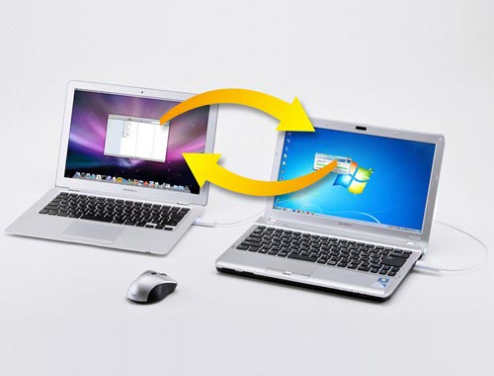
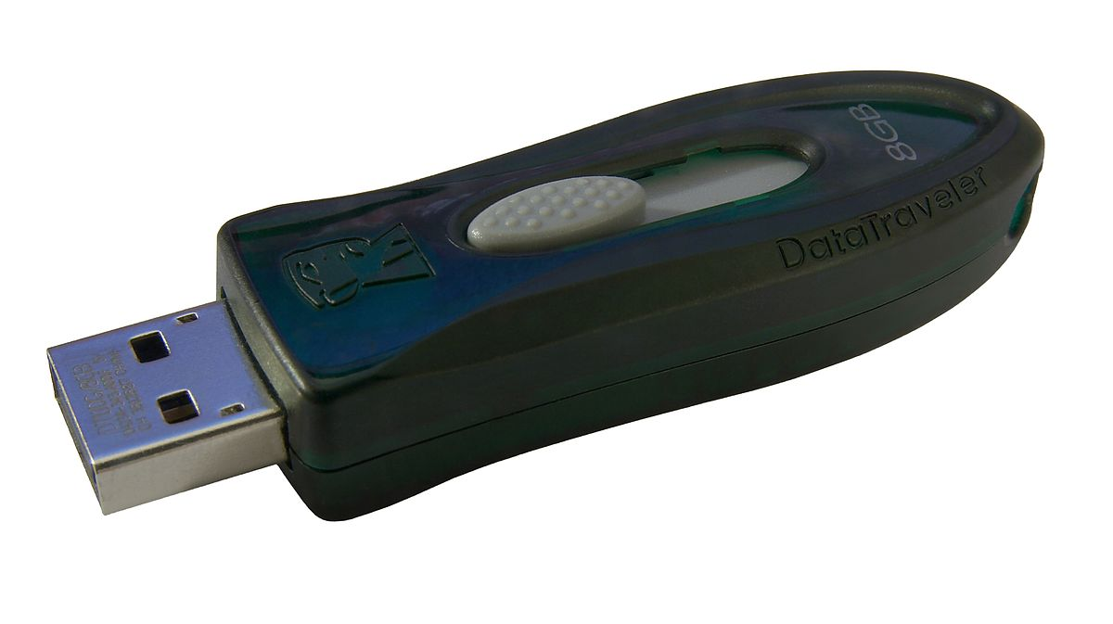
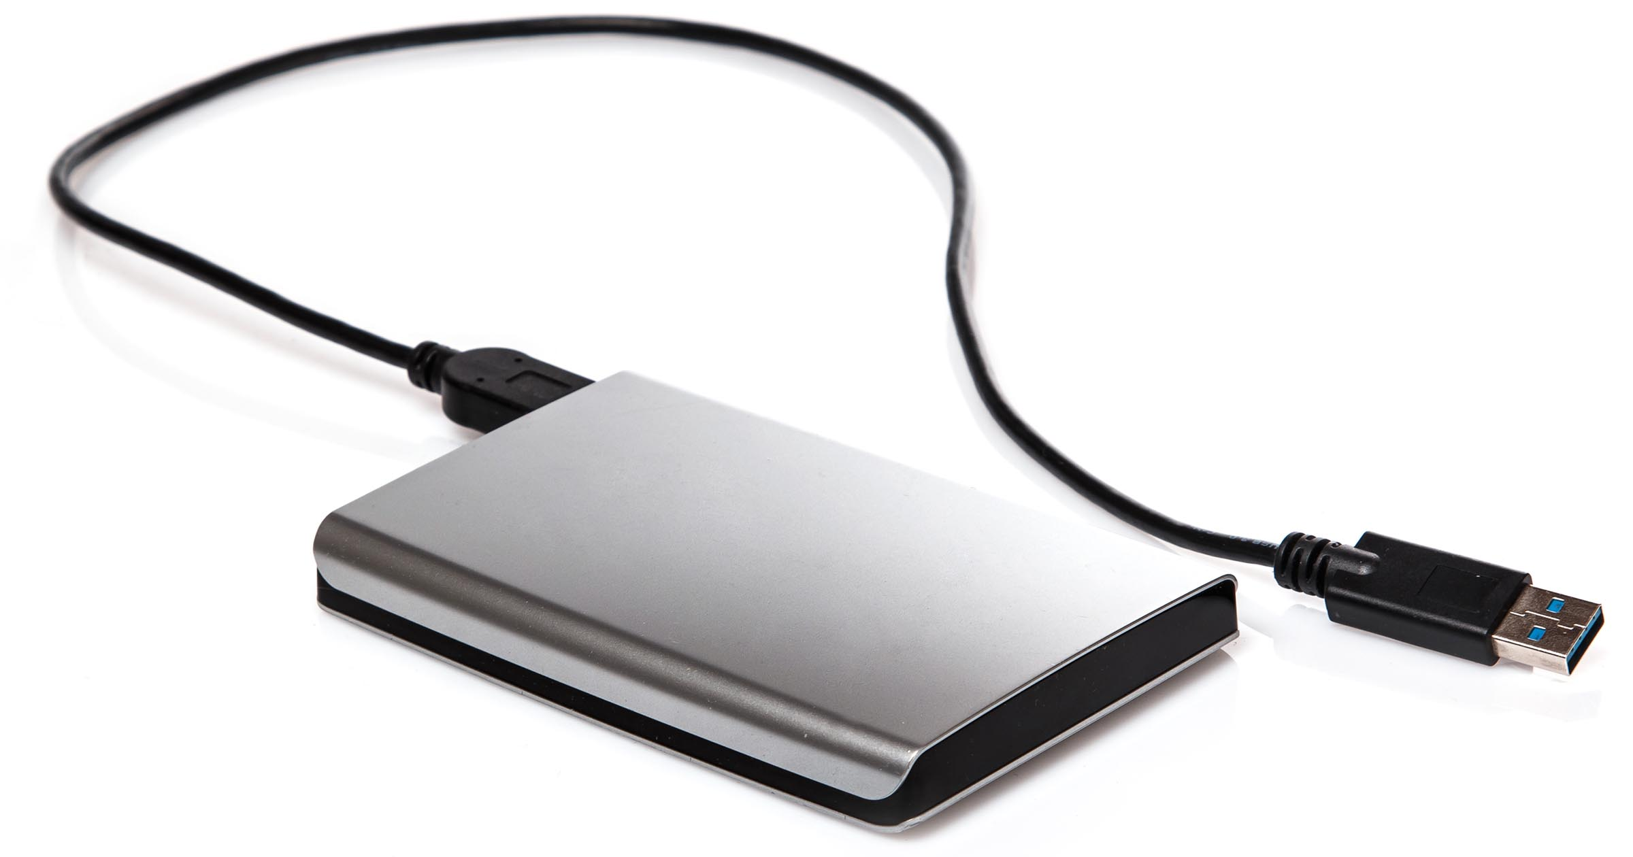
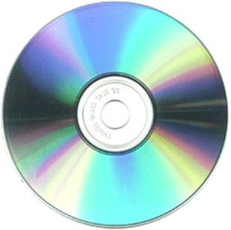

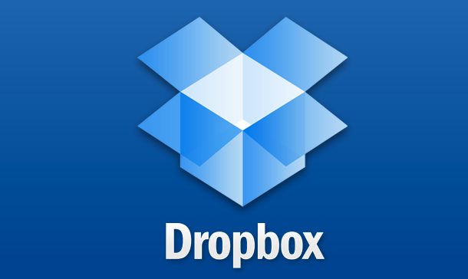
Section VII- File Transfer Methods
There are so many ways to transfer files and must common ones are:
USB attachment
External drives
CD / DVD
Email
Drop box
In corporate environment file transfer occur through
FTP (command available in dos and powershell)
File Sharing (Samba, NFS, etc)
3rd party software (Filezilla, EaseUS, FlashGet etc.)

Slide 15
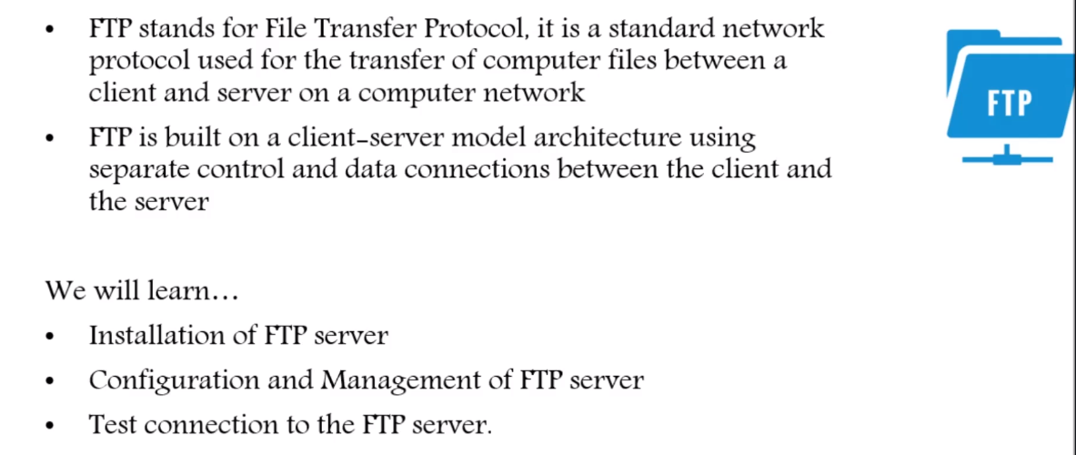
Section VIII- FTP Server Installation and Configuration
What is it?
FTP (File Transfer Protocol) is an abbreviation of File Transfer Protocol. As the name implies, FTP is used to transfer files between machines on a network. You can use FTP to share files between a local PC and a remote server and to access online software archives.

Slide 16
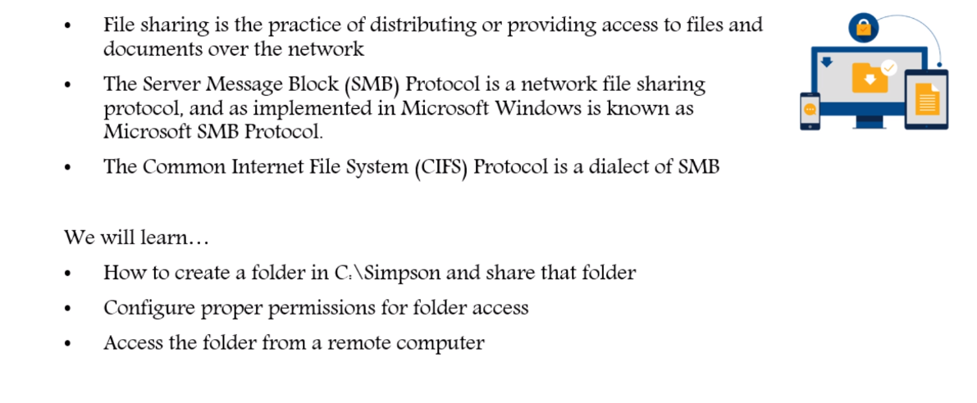
Section IX- Sharing File System (Samba or NFS)

Slide 17
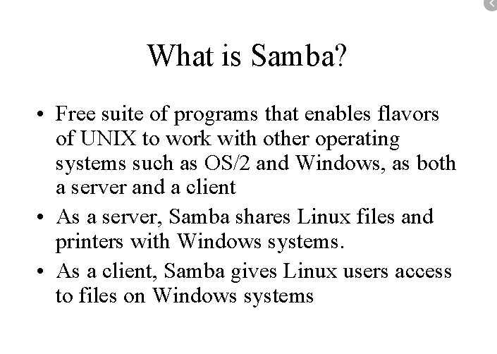
What’s SAMBA

Slide 18
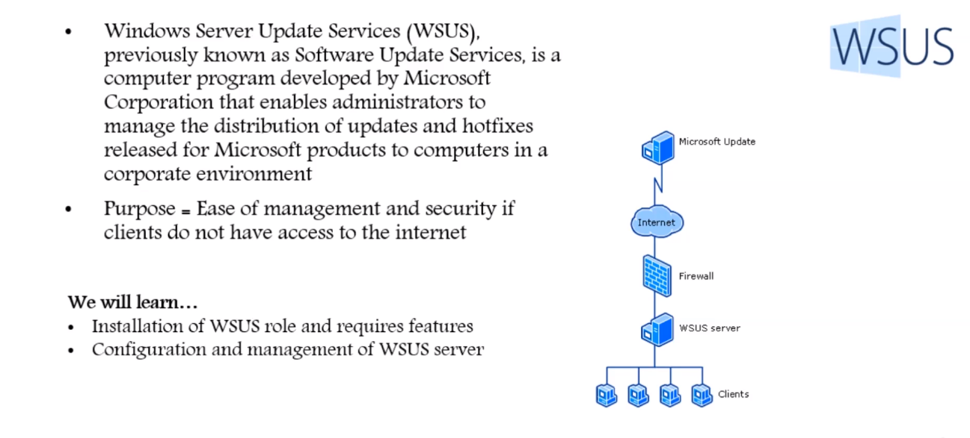
Section X- WSUS Server Installation and Configuration

Slide 19
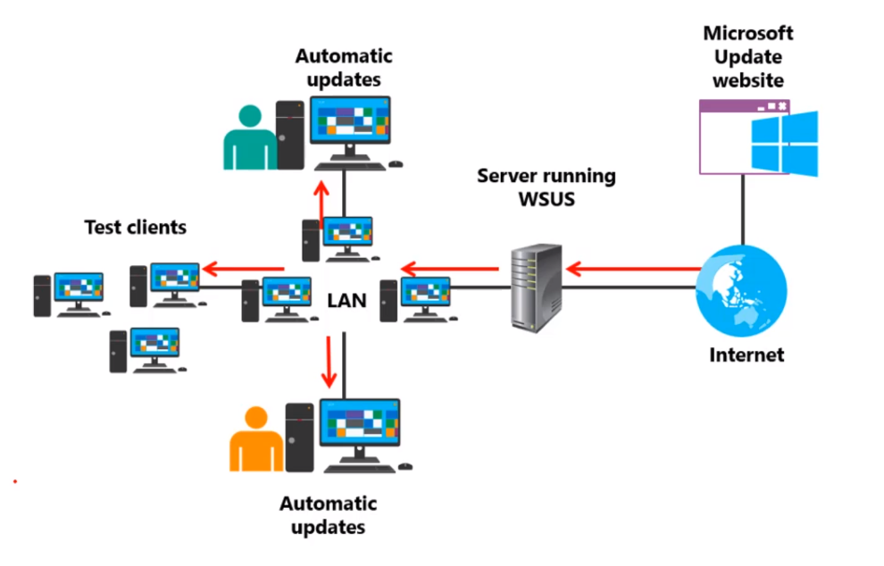
The benefits of having a WSUS server

Slide 20
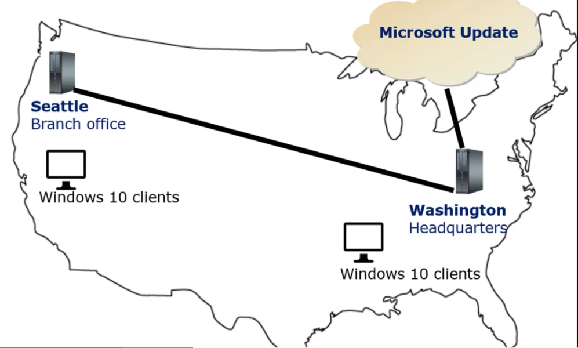
UPSTREAM AND DOWNSTREAM

Slide 21
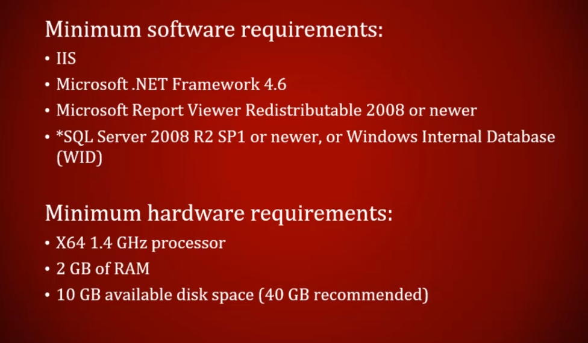
WSUS MINIMUM REQUIREMENTS

Slide 22
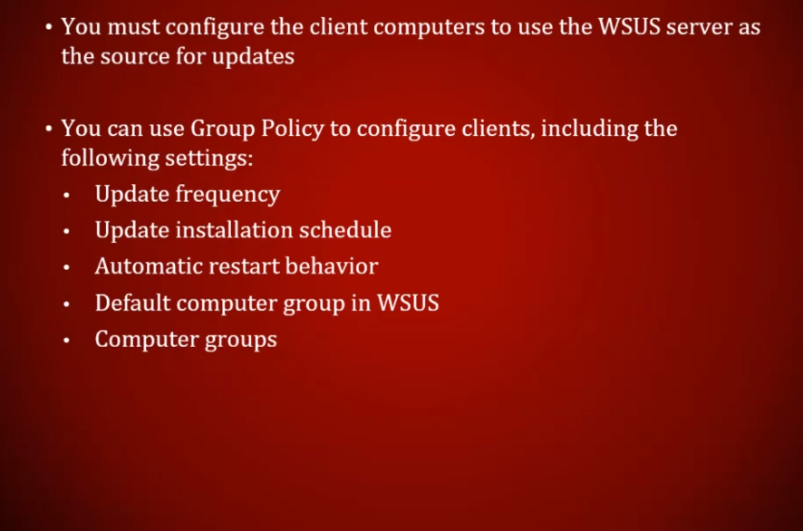
WSUS CLIENT CONFIGURATION

Slide 23
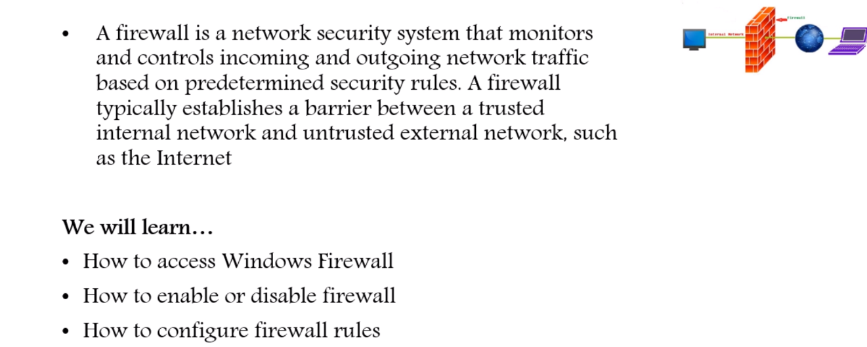
Section XI- Windows Firewall
The Windows Firewall is a security application created by Microsoft and built into Windows, designed to filter network data transmissions to and from your Windows system and block harmful communications and/or the programs that are initiating them.

Slide 24
FIREWALL RULES
Firewall rules are used to filter network traffic between the local computer and the network. To filter traffic means to allow or block traffic based on the filtering conditions specified in the rule.
Firewall rules in Windows Firewall with Advanced Security can be classified in various ways:
Inbound vs. outbound rules Determines the direction of the rule; that is, whether the rule applies to traffic passing from the network to the local computer or vice versa.
Allow vs. block rules Determines the action the rule takes; that is, whether the traffic specified by the rule will be permitted or not.
Allow if secure rules Indicates another action that a rule can take; namely, that only traffic protected using IPsec will be permitted.
Authenticated bypass rules Overrides blocking rules for properly authenticated traffic (an optional subtype of allow if secure rules).

